Slide 1
Presentation Task
Interactive Media
Unit 1

Slide 2
Starter – 5 Minutes
Write down the following on your whiteboards:
What is one thing that makes a presentation bad?
What is one thing that can be done to improve a presentation?

Slide 3
Learning Outcomes
Understand how to create a basic presentation.
Describe the steps taken to make a presentation interactive.
Understand what makes a good or bad presentation.

Slide 4
Lesson Structure
During this lesson, you will be shown the basic steps to set up a PowerPoint presentation. You will need to follow these steps as they are demonstrated.
Make sure that any content you put into the presentation is related to the brief given on the next slide.
Add the following heading to your portfolio: Interactive Presentation (Heading 1). Then add a table with two columns and eight rows.
Whenever you add something to the presentation, screenshot it and place that screenshot in the table.

Slide 5
Presentation – Brief
Brief: A local company that buys, restores and sells furniture would like a presentation to advertise their services.
The company is called Resture and is based in Parson Cross, Sheffield.
They buy mostly wooden furniture, restore and repair it, and then sell them on.
The presentation needs to show off their services as well as their prices:
£20 to restore a small chair
£30 to restore a large chair
£50 to restore a table
£40 to restore a sofa.

Slide 6
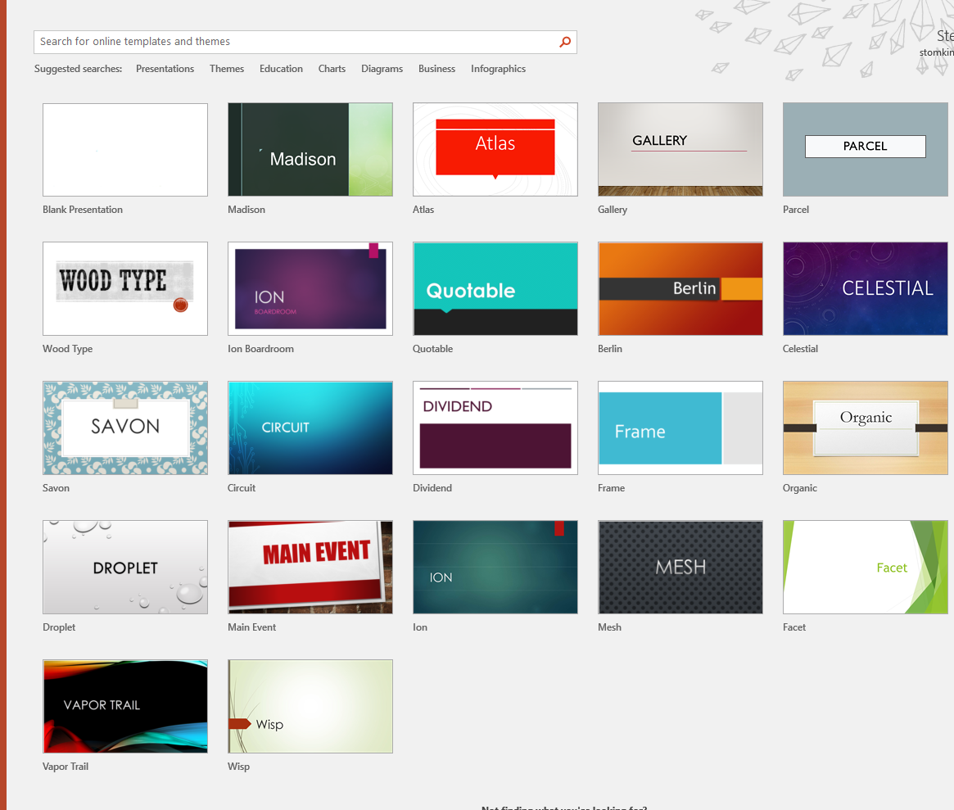
Creating a Presentation
Once you open PowerPoint, you will be presented with various different pre-made templates.
Select one that you think matches this brief.
Remember that you may be able to change the colour scheme of the template, so if you like the style but not the colour, you may be able to use it.

Slide 7

Setting the Cover
The cover slide is the first slide people will see when viewing the presentation.
It is a good idea to make it clear what topic this presentation is about, so add a succinct, clear title.
You can also include a subtitle that relates to the title.

Slide 8
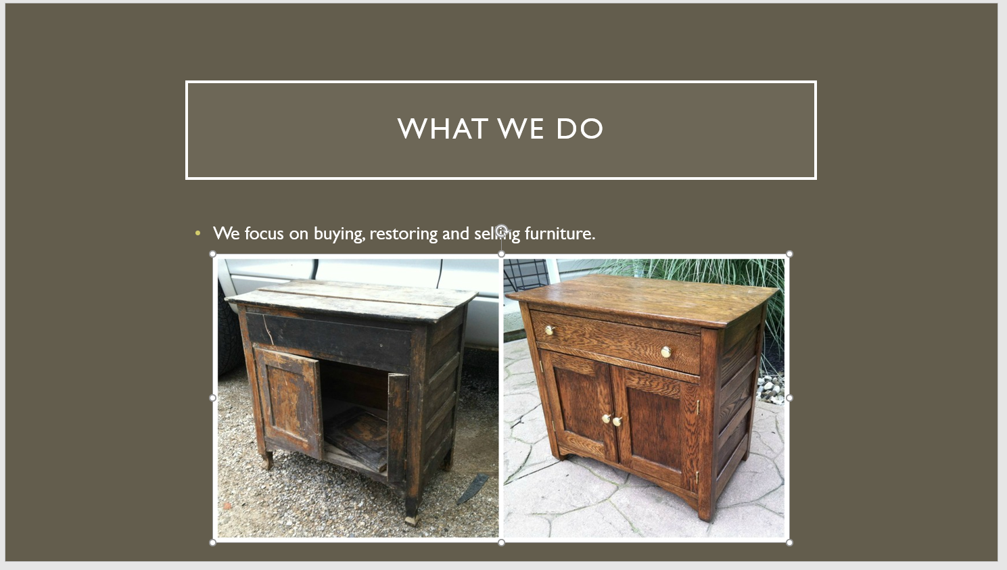
New Slides
Each new slide should only cover one specific topic and shouldn’t contain too much text. Including too much text on a slide can turn people away, they typically won’t be interested if they have to read a lot of text in order to understand the information that is meant to be shown to them. To avoid this, you should typically only include a small amount of text and some images or graphs or other content that helps illustrate the text.
In other words, small amounts of text and some supplementary images or charts to help the reader understand the content.

Slide 9
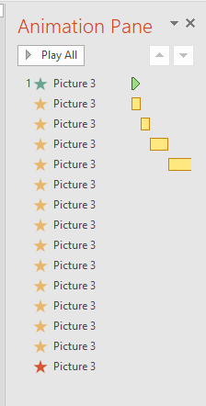
Improving the Slide
Currently, any slides might be a little dull, just text and images.
You can make content appear, more, disappear and other effects using Animations.
You can also view all of the animations for that slide by clicking the Animation Pane button.

Slide 10
Action Buttons
You have previously covered how to make Action Buttons with Mr. Parr.
Add a couple of action buttons to each slide that take you through the different slides.
These buttons should either be text matching the title of that slide or an image that relates to the slide.

Slide 11
Suggested Slides
The following slides are suggested for your presentation:
Title slide
“We Buy” slide
“We Restore” slide
“We Sell” slide
Prices slide

Slide 12
Task 1 – Using the Skills
Using the different skills and techniques you have been shown, add more content to your presentation for the brief below.
Make sure to screenshot and annotate your work!
Brief: A local company that buys, restores and sells furniture would like a presentation to advertise their services.
The company is called Resture and is based in Parson Cross, Sheffield.
They buy mostly wooden furniture, restore and repair it, and then sell them on.
The presentation needs to show off their services as well as their prices:
£20 to restore a small chair
£30 to restore a large chair
£50 to restore a table
£40 to restore a sofa.

